Slide 1
Final presentation for team 3
Team member:
Lei Zhenghong
Wang Weichen
Peng Yuqi

Slide 2
Executive summary
Key insight | Description
Key clustering of the users in GoTrade | High value trading users | Stable trading users | Less active trading users | Dormant Users
 | Highest trading volumes Highest operation time | High trading frequency Low trading volumes Low operation time | Lowest trading frequency Lowest trading volumes | High trading volumes Highest churn percentage
 | Four group have different characteristics in trading value, trading times/frequency, session times and operation times, especially “Dormant Users” group has some interesting findings.
Key insight from the important features | By explorating the SHAP value plot, we found that buy/sell numbers, net flow and the history total events have positive impact on the future trading values.
Marketing Strategies | The key recommendations are based on the four groups and our findings: High value trading users: Build a community, recommend the products and others strategies Stable trading users: Offer session time rewards Less active trading users: Offer trading frequency rewards and others Dormant Users: Offer limited-time discounts and exclusive offers Notification system

Slide 3
Leveraging features across Users profile, usage behavior, trades activities, deposit and withdrawals
Trades
Usage Behaviour
Number of buy/sell transactions
Amount of buy/sell transactions
Trading frequency
Net Flow
Market situation
Session length
Total events
Screen (Stock) event Count
Tap (Stock) event Count
Tap (Withdraw) event Count
User data
Deposit and Withdrawal
User profile
Number of withdrawals
Amount of withdrawals
Amount of deposit
Number of deposits
Churn percentage
Source of wealth
Employment status

Slide 4
Four groups were identified across the profit and loyalty spectrum
Group 1:
High value trading users
（718 (26.6%)）
Group 2:
Stable trading users
787 (29.1%)
Highest trading volumes
Highest operation time
Loyalty
High trading frequency
Low trading volumes
Low operation time
Group 3:
Less active trading users
336 (12.4%)
Group 4:
Dormant Users
466 (17.3%)
Lowest trading frequency
Lowest trading volumes
High trading volumes
Highest churn percentage
Profit

Slide 5
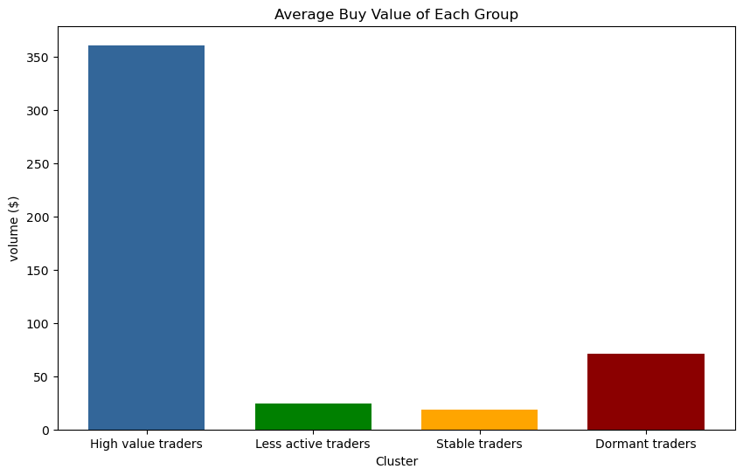

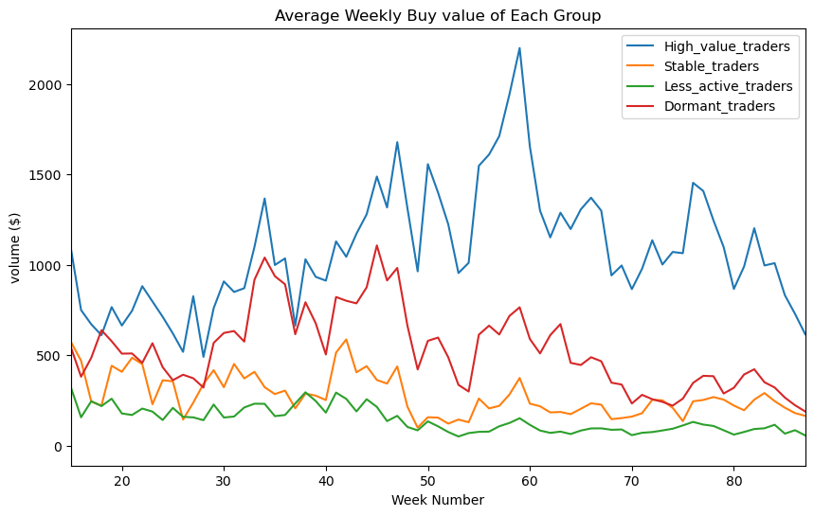
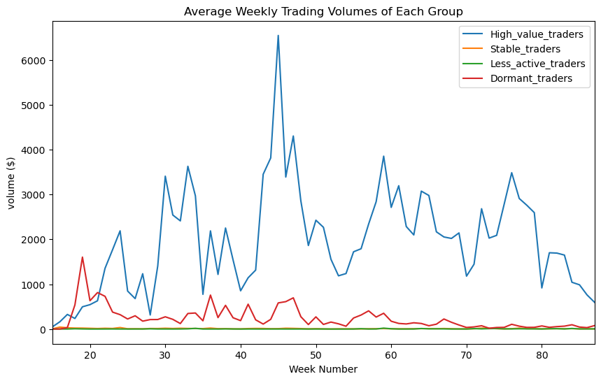
Explorations toward Trading Volume
High value trading users
Highest trading volumes
Highest operation time
Less active trading users
Lowest trading volumes
Lowest trading frequency
Stable trading users
Low trading volumes
High trading frequency
Low operation time
Dormant Users
Highest churn percentage
Less activity after they churn
Findings:
High value traders always have the highest buying value and trading volume while Stable traders and Less active traders both have a lower volume.
So, we should focus on keeping the high trading volume for high value group, as well as improving trading volume of stable trading users and less activate trading users.

Slide 6
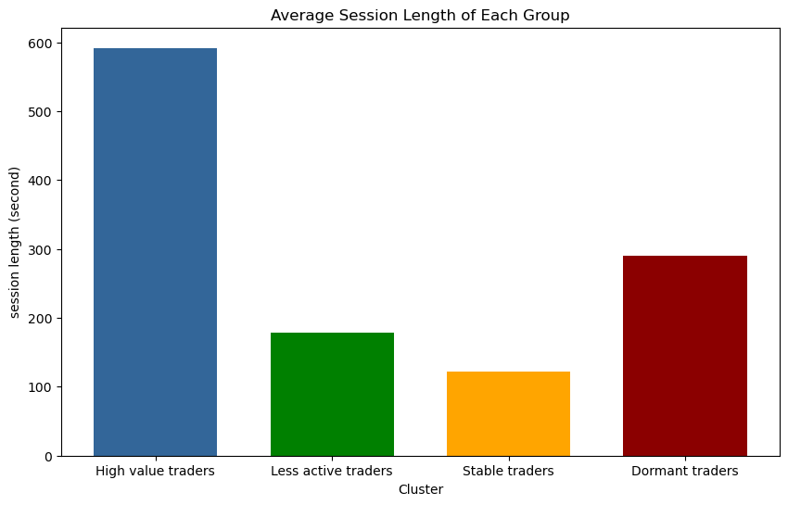
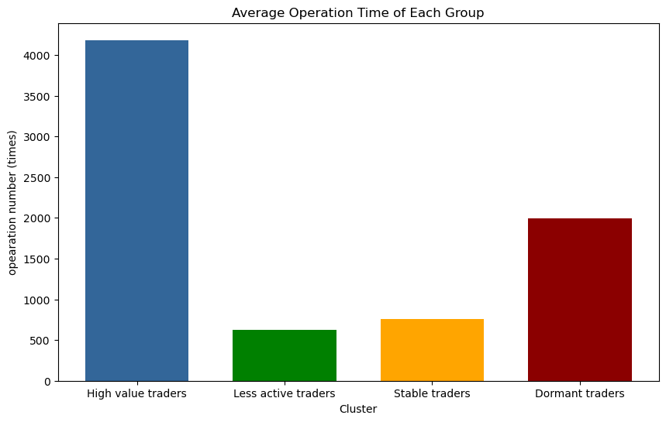
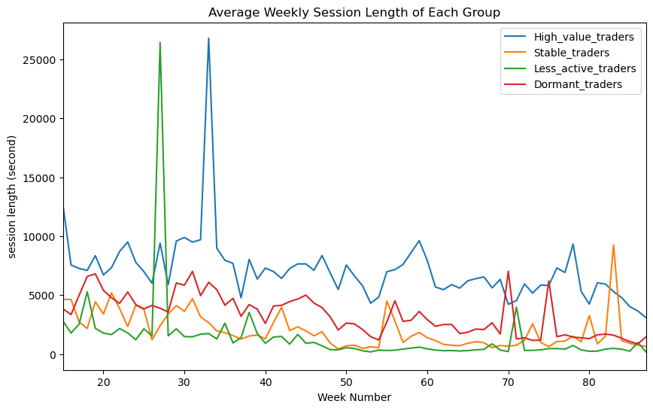
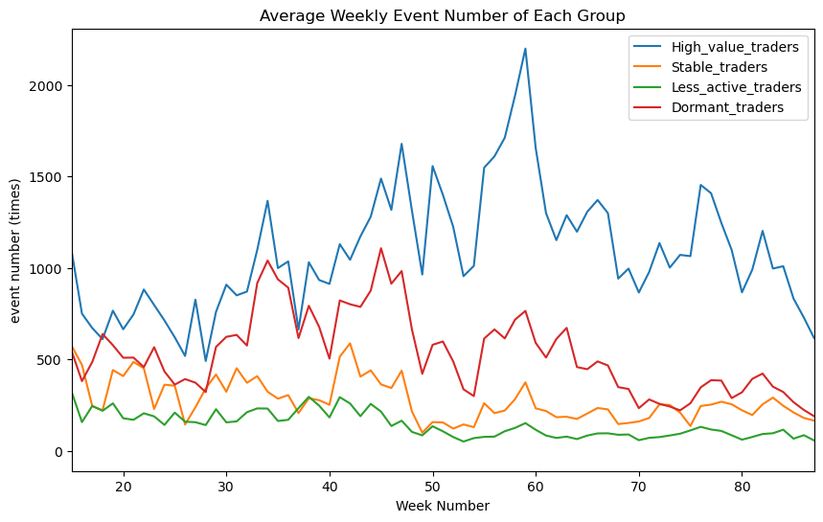
Explorations toward Operations
High value trading users
Highest trading volumes
Highest operation time
Less active trading users
Lowest trading volumes
Lowest trading frequency
Stable trading users
Low trading volumes
High trading frequency
Low operation time
Dormant Users
Findings:
High value trading group has the highest session length and operation times, while less active trading group and stable trading group have less activeness.
Dormant traders group seems to be active before they have churned.
So, we should focus on keeping the high operation time for high value trading group, as well as increasing less activate trading user’s operation time.
Highest churn percentage
Less activity after they churn

Slide 7
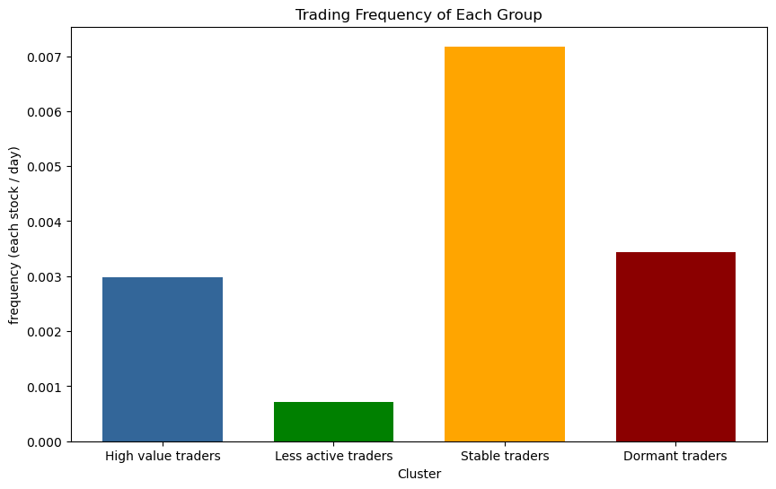
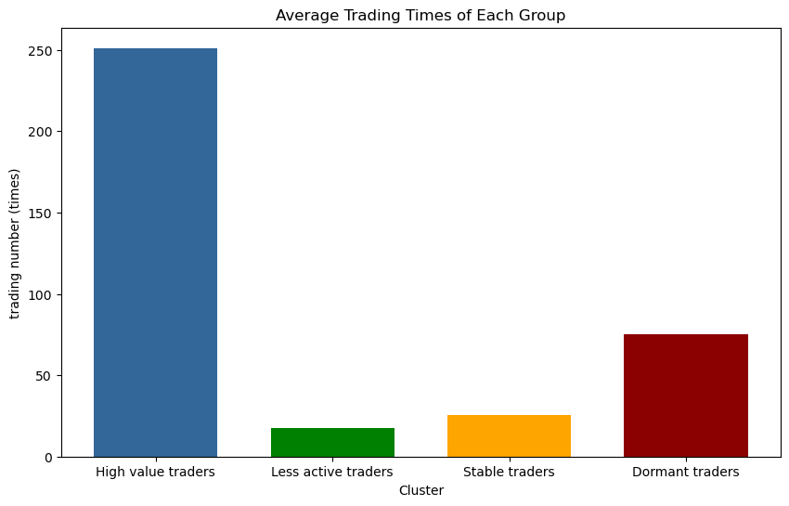
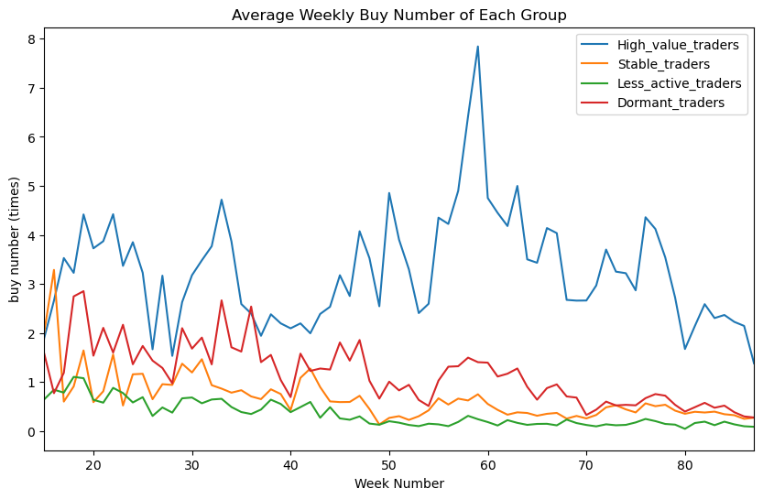
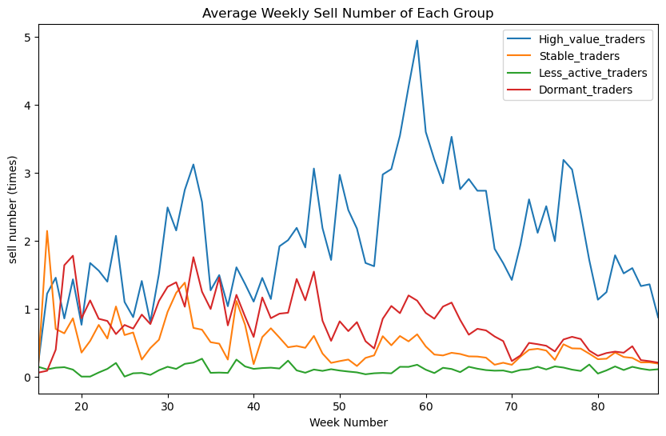
Explorations toward Trading Frequency
High value trading users
Highest trading volumes
Highest operation time
Less active trading users
Lowest trading volumes
Lowest trading frequency
Stable trading users
Low trading volumes
High trading frequency
Low operation time
Dormant Users
Highest churn percentage
Less activity after they churn
Findings:
Stable traders group has the highest trading frequency on each stock, while high value trading group has the highest number of trading
So, we should focus on keeping the high trading frequency for stable trading group, as well as improving less activate trading user’s trading frequency.

Slide 8
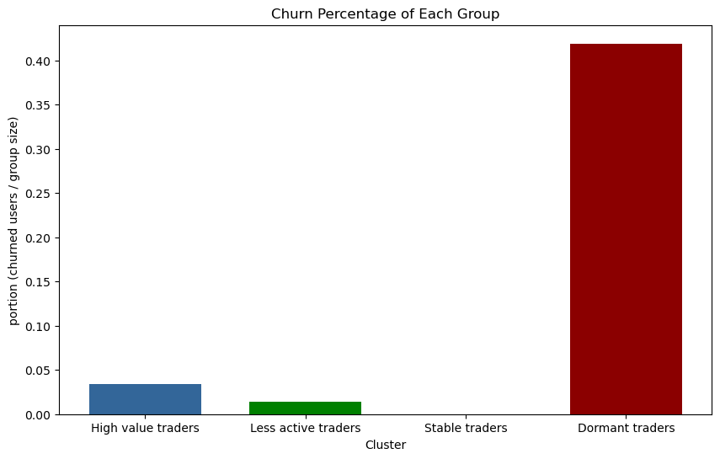
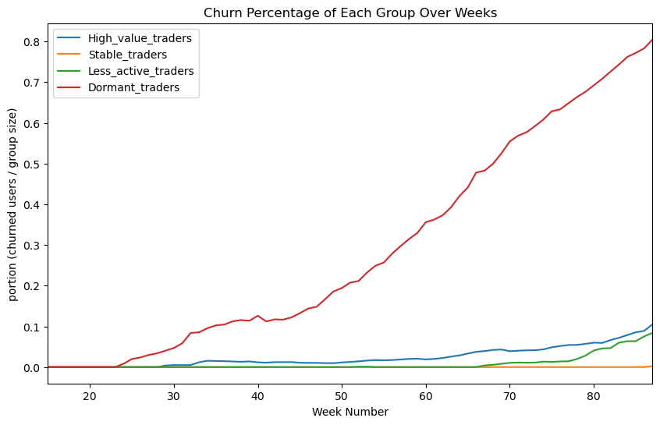
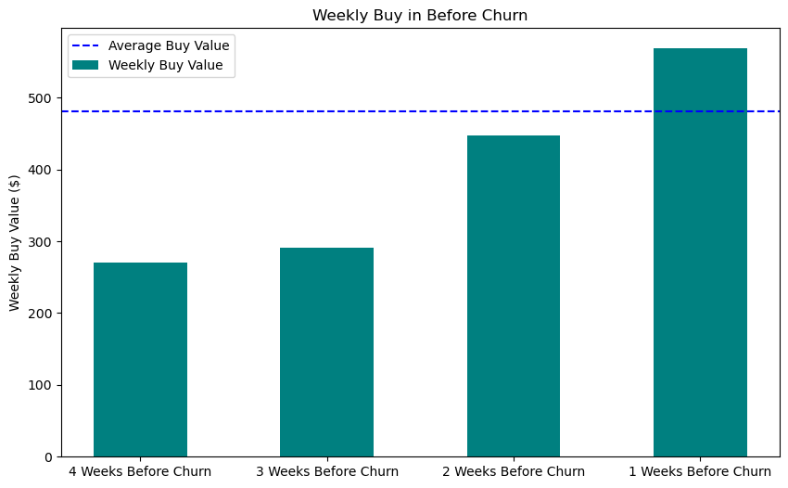
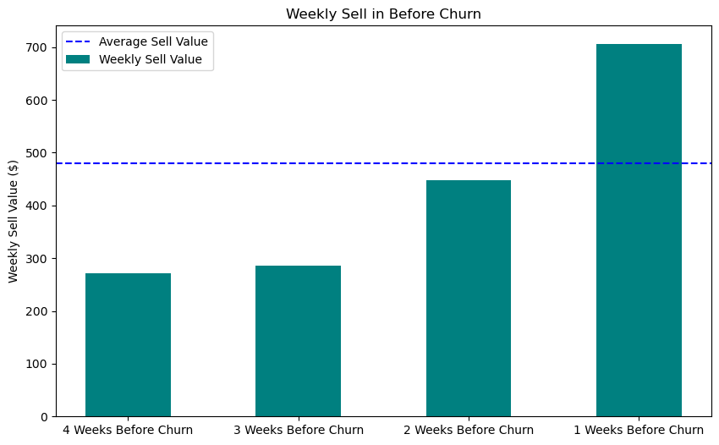
Deep-Dive into the Dormant Users Group
Dormant Users
Highest churn percentage
Less activity after they churn
Characteristics before they churn:
Increase in sell and buy volume
Increased willingness to withdraw
Observation:
The user’s buying volume and sell volume of the last two weeks before they have churned have a great increase.
In the last week, their buy volume and sell volume even exceed the average level of their past transaction.

Slide 9
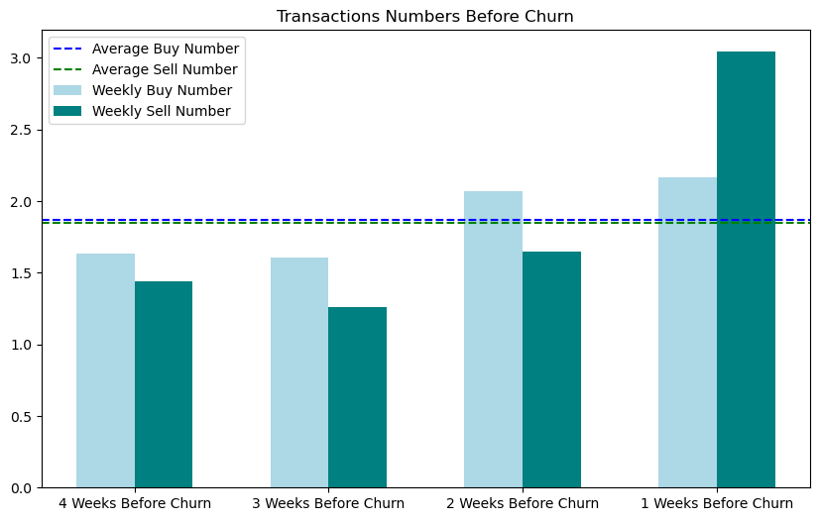
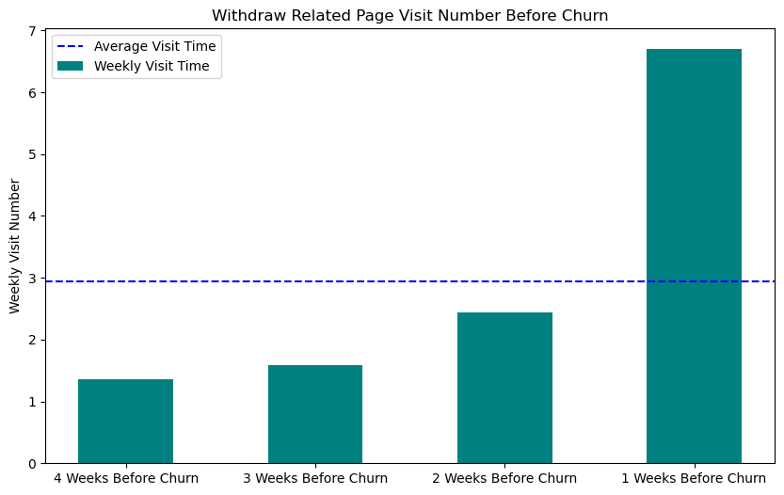
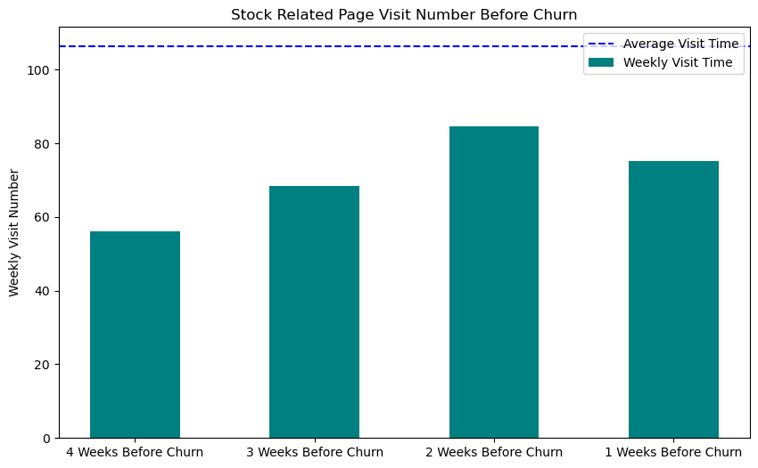
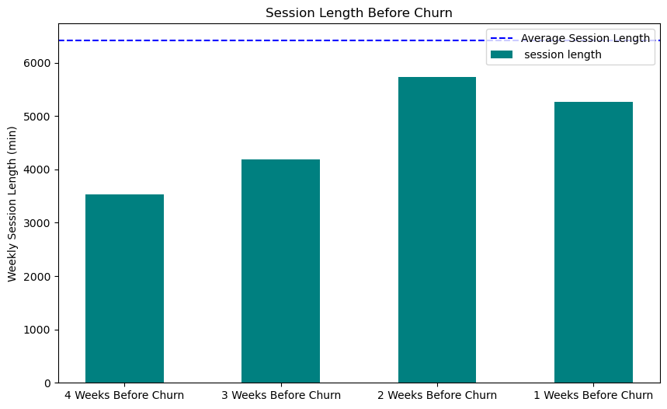
Deep-Dive into the Dormant Users Group
Dormant Users
Highest churn percentage
Less activity after they churn
Characteristics before they churn:
Increase in sell and buy volume
Increased willingness to withdraw
Observation:
In the first three weeks, weekly buy number is higher than weekly sell number, however, in the last week, sell number exceed buy number.
Before these users churned, although there is an increasing trend both in trading volume and trading frequency, their operations in the software do not increase.

Slide 10
Evaluating the model of the prediction for future transaction
 | MAE | RMSE
High value trading users
Decision Tree Regressor | 4827.1 | 44680.1
Gradient Boosting Regressor | 3355.3 | 24289.7
Stable trading users
Decision Tree Regressor | 25.44 | 293.5
Gradient Boosting Regressor | 21.21 | 245.2
Less active trading users
Decision Tree Regressor | 18.55 | 166.1
Gradient Boosting Regressor | 14.87 | 116.9
Dormant Users
Decision Tree Regressor | 488.6 | 5515.4
Gradient Boosting Regressor | 344.9 | 4005.3
Target variable:
The target variable is setted to be the next week‘s transaction values of each users.
Regression Model:
Gradient Boosting Regressor:
Be able to capture nonlinear relationships in the data.
Be able to process data sets containing numerical and categorical features.
Be able to capture the complex interactions between features.
Cross validation: 10 fold
Grid Search (GridSearchCV)

Slide 11
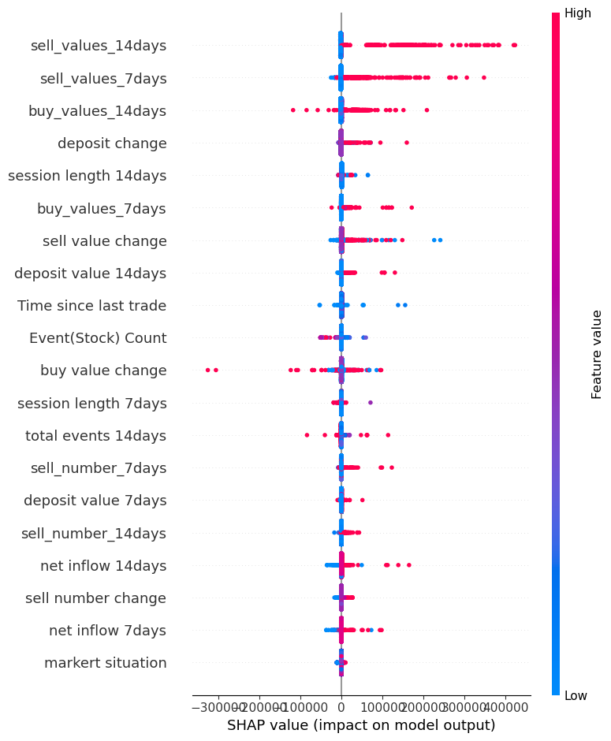
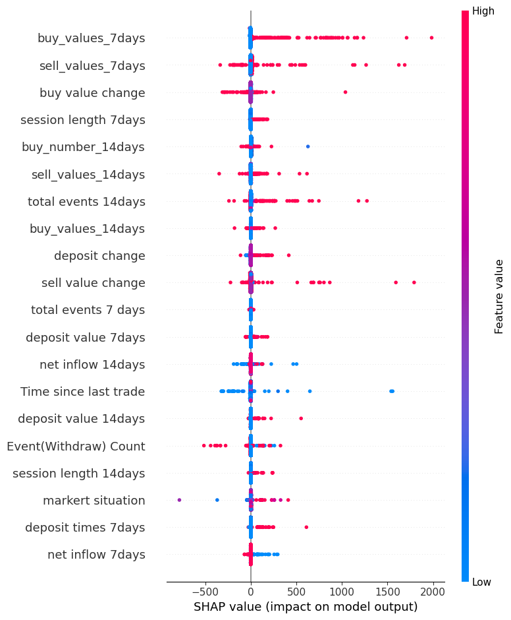
SHAP Value Analysis
High value trading users
Dormant Users
Observations:
Blue part and red part refers to the low feature value and high feature value.
Focus on the feature that has clear separation between blue part and the red part.
If we look at buy_values_7_days, it is mostly high with a positive SHAP value. This means that higher buy values within 7 days would tend to positively affect the output

Slide 12
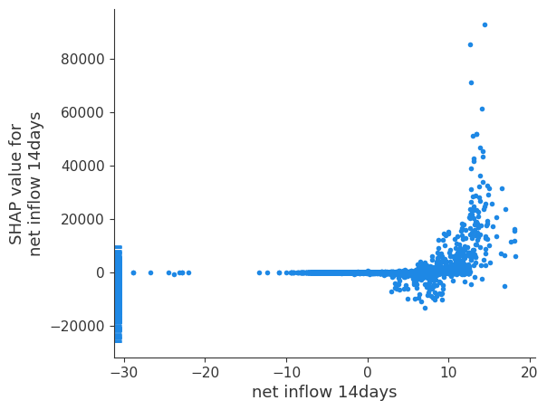
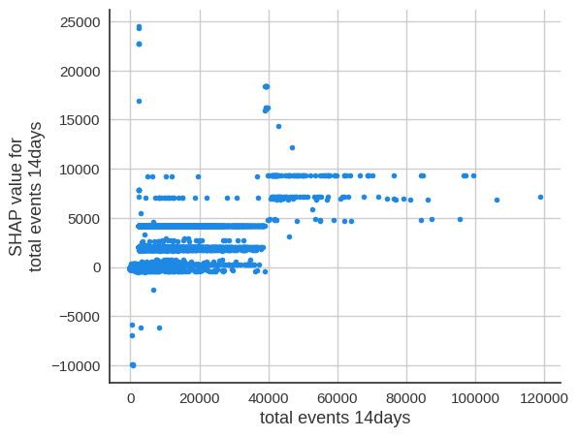
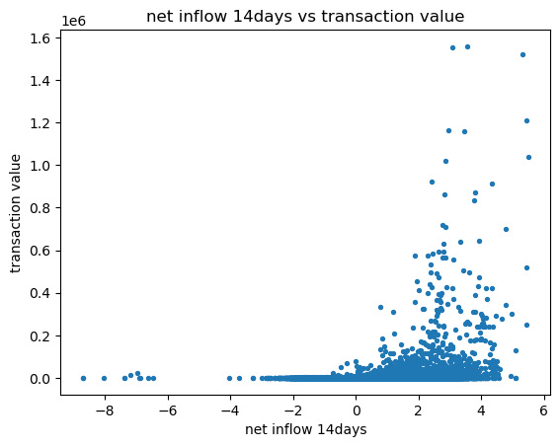
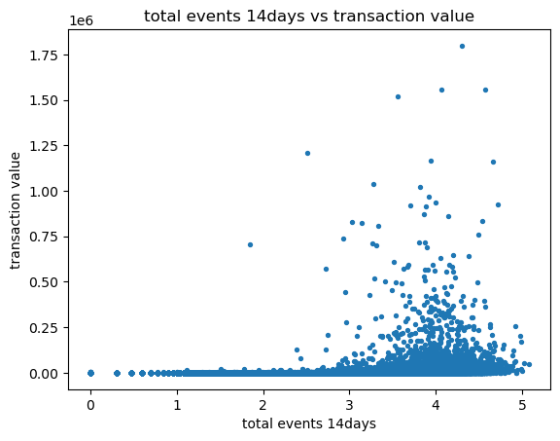
Features that related to the user’s future trading volumes
Observation:
When net flow < 0, the SHAP value is less than 0, indicating total trading volume in the next 7 days may decrease. While when net flow > 0, user’s total trading volume in the future may increased.
From the scatter plot we can see that users tends do more transaction in the future as they earned money in the past.
When the total events > 40000, it has high impact on transaction value in the next 7 days. While lower total events may have less impact.
From the scatter plot we can see that users tends do more transaction in the future as they spent more events in the past, especially after 40000 total events.

Slide 13
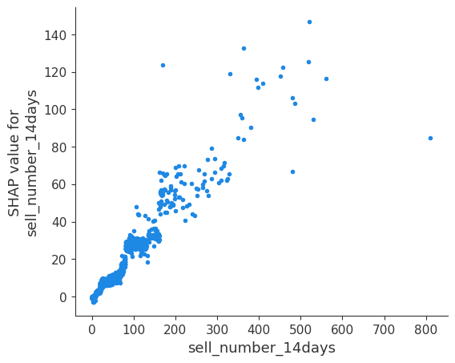
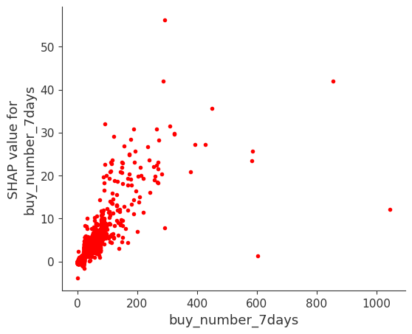
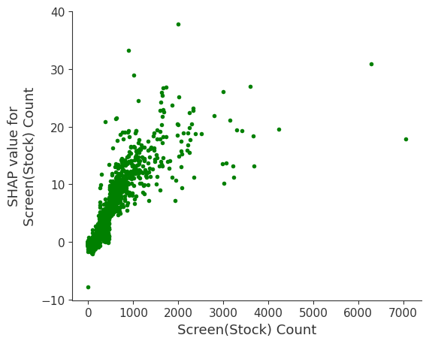
The causal drivers responsible for the number of buying a user will make in the future
Observation:
Higher number of sell in the past 14 days may increase the number of buy that the user will make in the next week. This indicates that the number of buys and sells by the user are mutually driving each other.
The increasing of the number of buy in the past 7 days may increase the number of buy of the user in next week. Indicating that user buying behavior exhibits a certain level of continuity.
The more stock-related screens a user visits, the more likely they are going to buy in the next week.

Slide 14
Summary of the marketing strategies
High value trading users
Stable trading users
All applicable strategies
Recommend the products in the user’s best preference sector (Medium cost)
- Based on the history product sectors, recommend the product in same sector.
Offer trading value rewards (Low cost)
- Set the monthly goals of trading values.
Offer session time rewards (Low cost)
- Set the goal of session time they spend on Gotrade weekly/monthly.
Recommend the products in the user’s multiple sectors (Medium cost)
- Based on the history product sectors, recommend the product in similar sector.
Build a community (Medium cost)
Offer rewards to encourage more deposit (Low cost)
- Offer rewards once they deposited again from a period of time.
Offer rewards to encourage less withdraw (Low cost)
- Offer them rewards once the balance have lower a certain amount within period of time.
Offer negative net flow rewards (Low cost)
- Offer them cash back for their first buying next week after when net flow < 0.
Notification system (Medium cost)
- Inform users of changes in owned products.
Less active trading users
Dormant Users
Offer trading frequency rewards (Low cost)
- Set the goal of the number of trading with a time limited.
Provide financial and investment educational resources (Medium cost)
- Provide financial and investment lectures and invite experts to answer the questions.
Offer limited-time discounts or exclusive offers (Low cost)
- Offer products with less fees and then provide exclusive offers after transactions.
Send personalized emails or messages (Low cost)
- Inform the trend of the stock they have brought, or recommend promising stocks.

Slide 15
Marketing strategies for high value trading users
Findings
Strategies
What we believe
Offer trading value rewards (Low cost)
Set the monthly goals of trading values. Once they have achieved the goals, we can offer them products with less fees or cash back.
High trading volume correlated with high profit
Encourage them to achieve the goals, instead of relying entirely on their own willing to trade and keep high trading.
Build a community (Medium cost)
The community allows users to post their opinion and investment experience in the community, while other users can also view what they have posted and make comment on it.
The community will update market news and recommend news for different segment of users based on their profile.
High operation time correlated with high loyalty
The total events have a positive impact on the transaction value in the future
The professional ideas and experiences from high value trading users will interact other users to spend more time on the app and become more confident in trading.
Meanwhile, these posts can attract new users to join the GoTrade.
The recommended news will interact the users to increase the event on the app.
High number of average trading times correlated with high profit and loyalty
Recommend the products in the user’s best preference sector (Medium cost)
Based on the sectors of the product that each users has brought, we can recommend the product that are in the same sector.
Since average trading times is high, the accuracy for recommendation will be outstanding, so we apply more calculation.
Providing personal recommendation can help remaining their high trading frequency.

Slide 16
Marketing strategies for stable trading users
Findings
Strategies
What we believe
Offer session time rewards (Low cost)
Set the goal of session time they spend on Gotrade weekly/monthly. Once they reached the rewarding session time, we can offer them products with less fees.
Low operation time correlated with low loyalty
Therefore we want to increase operating time
Encouraging the users to use GoTrade more frequently. Thereby increasing users engagement and making them more inclined to use GoTrade in the long term.
Recommend the products in the user’s multiple preference sectors (Medium cost)
Based on the sectors of the product that each users has brought, we can recommend the products that are in the similar sector.
Since the number of average trading times is low, the accuracy for recommendation may not be outstanding, so we apply less calculation. Therefore we recommend products in multiple sectors instead of specific sector.
Providing personal recommendation can help remaining their high trading frequency.
High trading frequency correlated with high loyalty

Slide 17
Marketing strategies for less active trading users
Findings
Strategies
What we believe
Low trading frequency correlated with low loyalty and profit
Therefore we want to increase trading frequency
Offer trading frequency rewards (Low cost)
Set the goal of the number of trading with a time limited. Once they reached the goal of the number, we can offer them products with less fees and cash back.
Encouraging the users to trade more frequently, instead of relying entirely on their own willing to trade, as the rewards can drive them to do more trading to achieve the goal.
Low trading volume correlated with low profit
Therefore we want to increase trading volume.
Provide financial and investment educational resources (Medium cost)
The app can provide some financial and investment lectures and invite experts to answer the questions.
Since their number of trading is small and the trading frequency is low, providing them educational resources can improve their investment skills.
Therefore they will become more confident in trading.

Slide 18
Marketing strategies for dormant users
Findings
Strategies
What we believe
More than 80% users in this group have churned
The increasing churn percentage represent a decline in the loyalty of this group of users
Offer limited-time discounts and exclusive offers (Low cost)
Once they return to GoTrade, we can first offer them products with less fees.
After they have successfully make a few trading, we can further offer them some exclusive offers such as cash back. These offers will stop after they have been trading for a few weeks.
The main purpose is to encourage them get back and trade on GoTrade again.
To prevent losing money cause by fake operations. We can first attract them by discount in fees. Then, to keep their interest in our app, we can offer them small amount of cash back weekly once they successfully make transactions.
This group used to bring profits to GoTrade
Send personalized emails or messages (Low cost)
After they have churned, we can send personalized emails to inform them the recent trend the product they once brought, or recommend some promising stocks.
We want to use personalized messages to stimulate users’ interest in trading. In addition, it can also makes users feel valued.

Slide 19
Marketing strategies based on the key insight from the important features
Findings
Strategies
What we believe
Offer rewards based on behaviour (Low cost)
When the user has not deposit for a period of time, we can offer them products with less fees or cash back once they deposited again.
When user's balance in his account have lower a certain amount within period of time, we can offer them rewards such as discounts in fee.
Encourage users to make deposit more often, instead of relying on their own when the balance is not enough to buy the product, as the reward can drive them to deposit more times.
Meanwhile, this can encourage the user to leave the money inside the account instead of withdrawing.
Increasing in the number of deposits will increase the number of buy in the future
Increasing in the withdraw value will result in a decrease for the total trading in the future
Notification system (Medium cost)
Establish a real-time notification system to inform users of changes in owned products. Users will be notified when the value of the products they owned increases.
Offer negative net flow rewards (Low cost)
When users weekly/monthly net flow is lower than zero, we can offer them cash back for their first buying next week.
The notifications for the changes of users’ owned product will help the users to have more comprehensive consideration in the trading, so that they will be more likely to earn money and do more trading in the future.
Once the users have lost money for this week, the trading in the future will decrease. Therefore the provided reward will simulate them to trade in the next week.
Net flow < 0, total trading in the next 7 days will decrease

Slide 20
Summary of the marketing strategies
High value trading users
Stable trading users
All applicable strategies
Recommend the products in the user’s best preference sector (Medium cost)
- Based on the history product sectors, recommend the product in same sector.
Offer trading value rewards (Low cost)
- Set the monthly goals of trading values.
Offer session time rewards (Low cost)
- Set the goal of session time they spend on Gotrade weekly/monthly.
Recommend the products in the user’s multiple sectors (Medium cost)
- Based on the history product sectors, recommend the product in similar sector.
Build a community (Medium cost)
Offer rewards to encourage more deposit (Low cost)
- Offer rewards once they deposited again from a period of time.
Offer rewards to encourage less withdraw (Low cost)
- Offer them rewards once the balance have lower a certain amount within period of time.
Offer negative net flow rewards (Low cost)
- Offer them cash back for their first buying next week after when net flow < 0.
Notification system (Medium cost)
- Inform users of changes in owned products.
Less active trading users
Dormant Users
Offer trading frequency rewards (Low cost)
- Set the goal of the number of trading with a time limited.
Provide financial and investment educational resources (Medium cost)
- Provide financial and investment lectures and invite experts to answer the questions.
Offer limited-time discounts or exclusive offers (Low cost)
- Offer products with less fees and then provide exclusive offers after transactions.
Send personalized emails or messages (Low cost)
- Inform the trend of the stock they have brought, or recommend promising stocks.

Slide 21
Thanks

Slide 22
Appendix

Slide 23
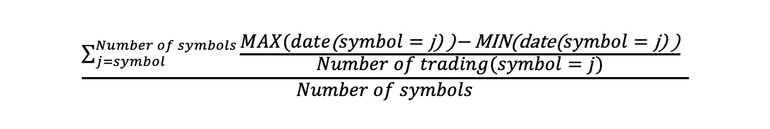
Appendix for formula of trading frequency

Slide 24
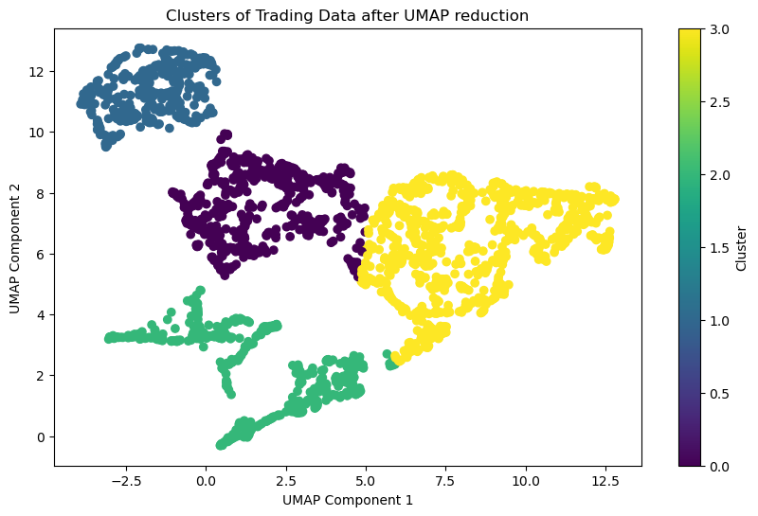
Model Features for case study 1
01
Trading features
Number of trading
Deposit (Average deposit amount)
Buy (Average purchase amount）
Trading frequency
02
Loyalty features
Account set up time (KYC started and account opened at)
Churn percentage (The ratio of is_churn to account existing day)
Number of session
Screen and tap point (screen segment and tap segment)

Slide 25
Model Features for case study 2
Trades
Deposit and Withdrawal
Usage Behaviour
Personal Information
Number of buy transactions(7&14 days)
Amount of buy transactions(7&14 days)
Number of sell transactions(7&14 days)
Amount of sell transactions(7&14 days)
Changes in sell/buy values
Changes in sell/buy numbers
Net Flow
Market situation
Number of withdrawals(7&14 days)
Amount of withdrawals(7&14 days)
Amount of deposit(7&14 days)
Number of deposits (7&14 days)
Churn percentage
Session length(7&14 days)
Total events(7&14 days)
Changes in session length
Changes in total events
Screen (Stock) event Count
Tap (Stock) event Count
Tap (Withdraw) event Count
Source of wealth
Employment status

Slide 26
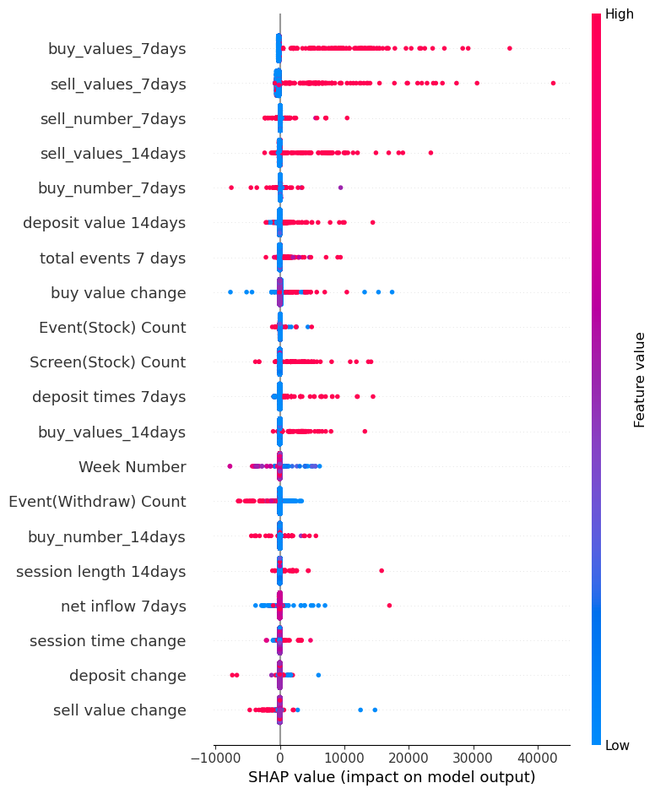
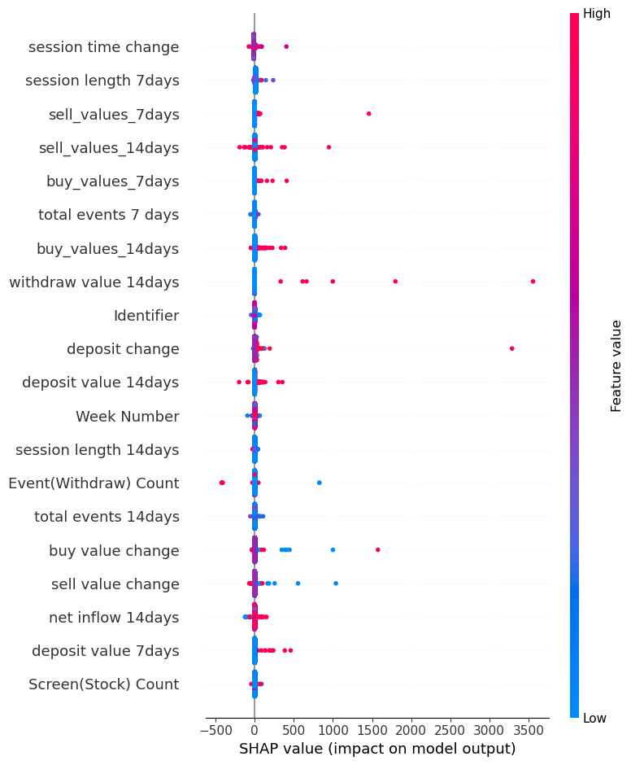
Appendix for SHAP Value Analysis of four groups
High value trading users
Dormant Users
Stable trading users
Less active trading users

Slide 27
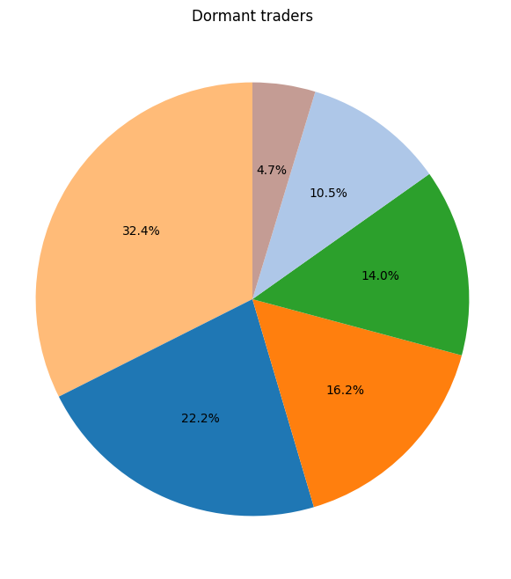
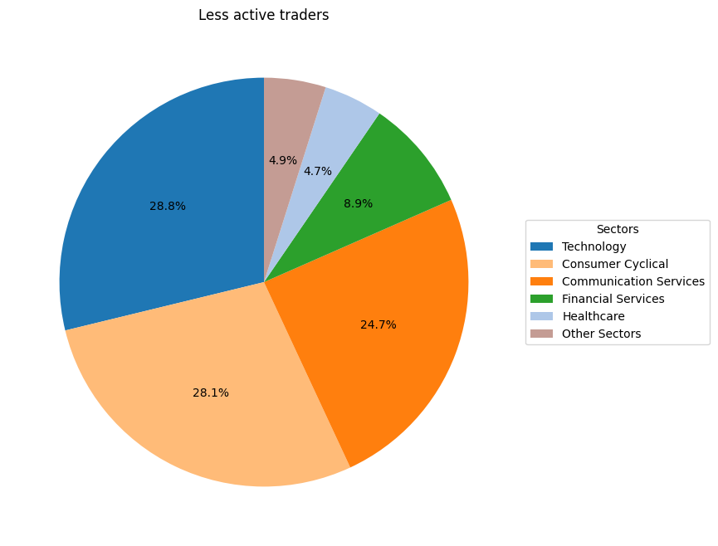
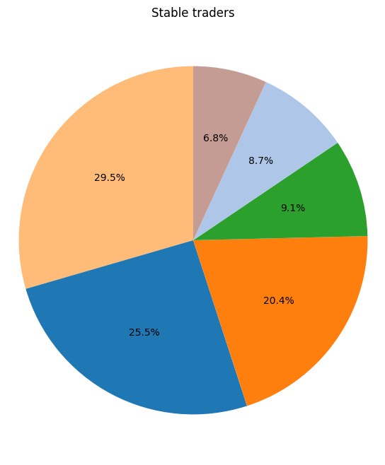
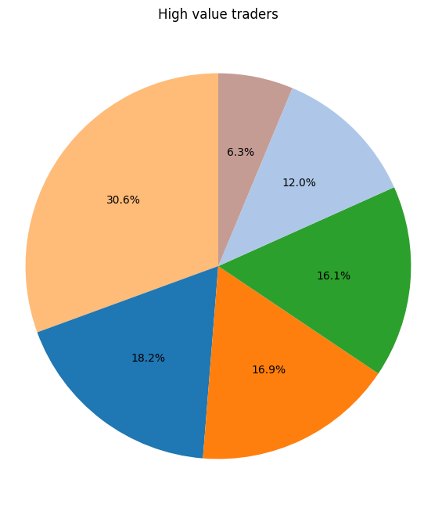
Appendix for the preference sectors

Slide 28

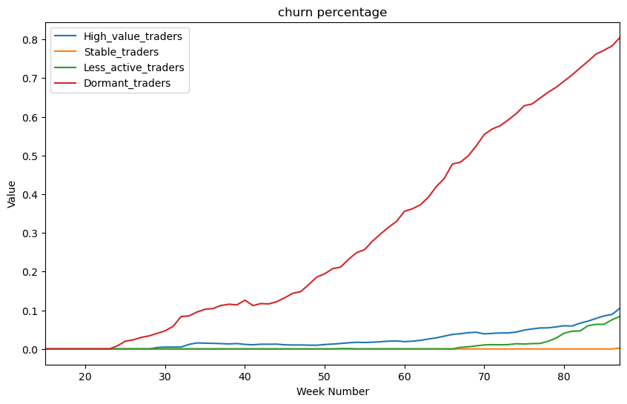
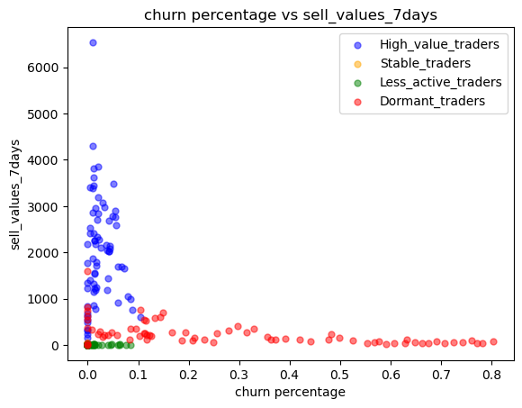
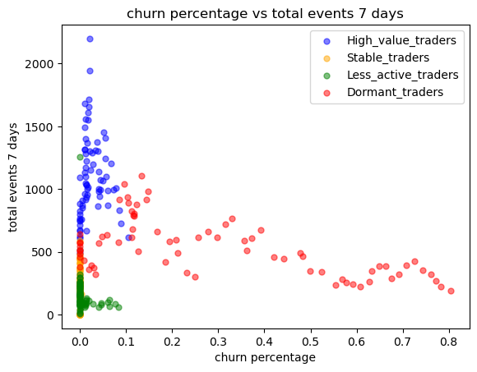
Model insights for the segments of the dormant users
## Do the exploration the period that they haven’t churn.
Dormant Users
Highest churn percentage
Less activity after they churn

Slide 29
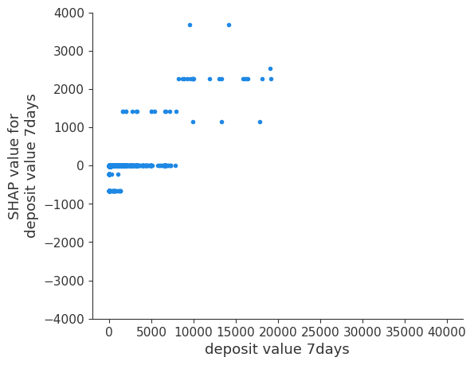
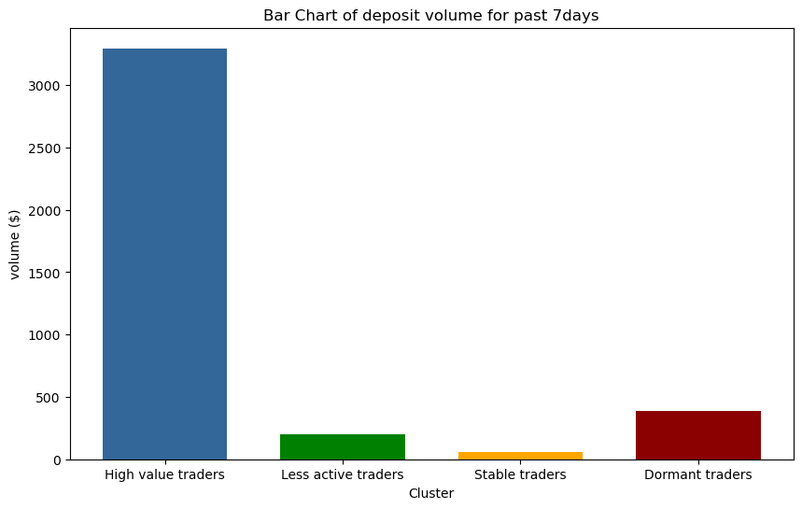
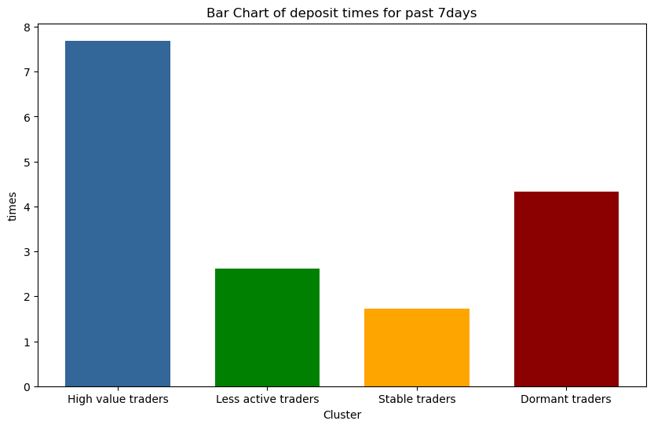
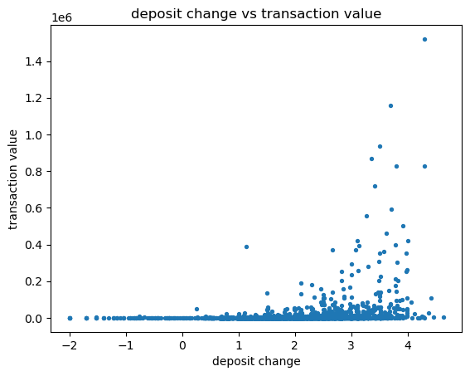
The causal drivers responsible for the value of transactions a user will make in the future ## If make sense, do the exploration about the characteristics.

